Slide 1
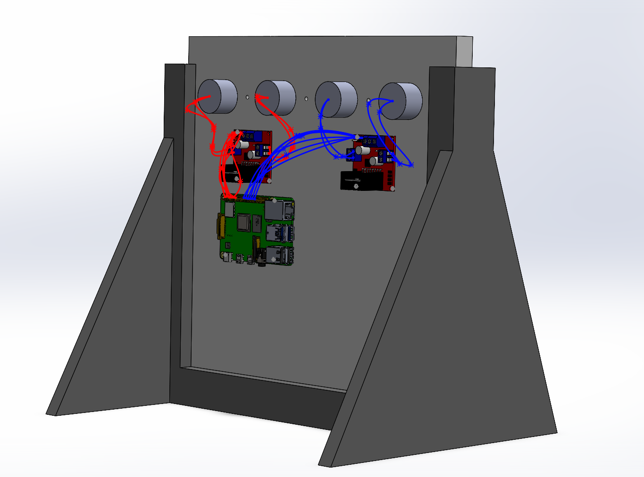
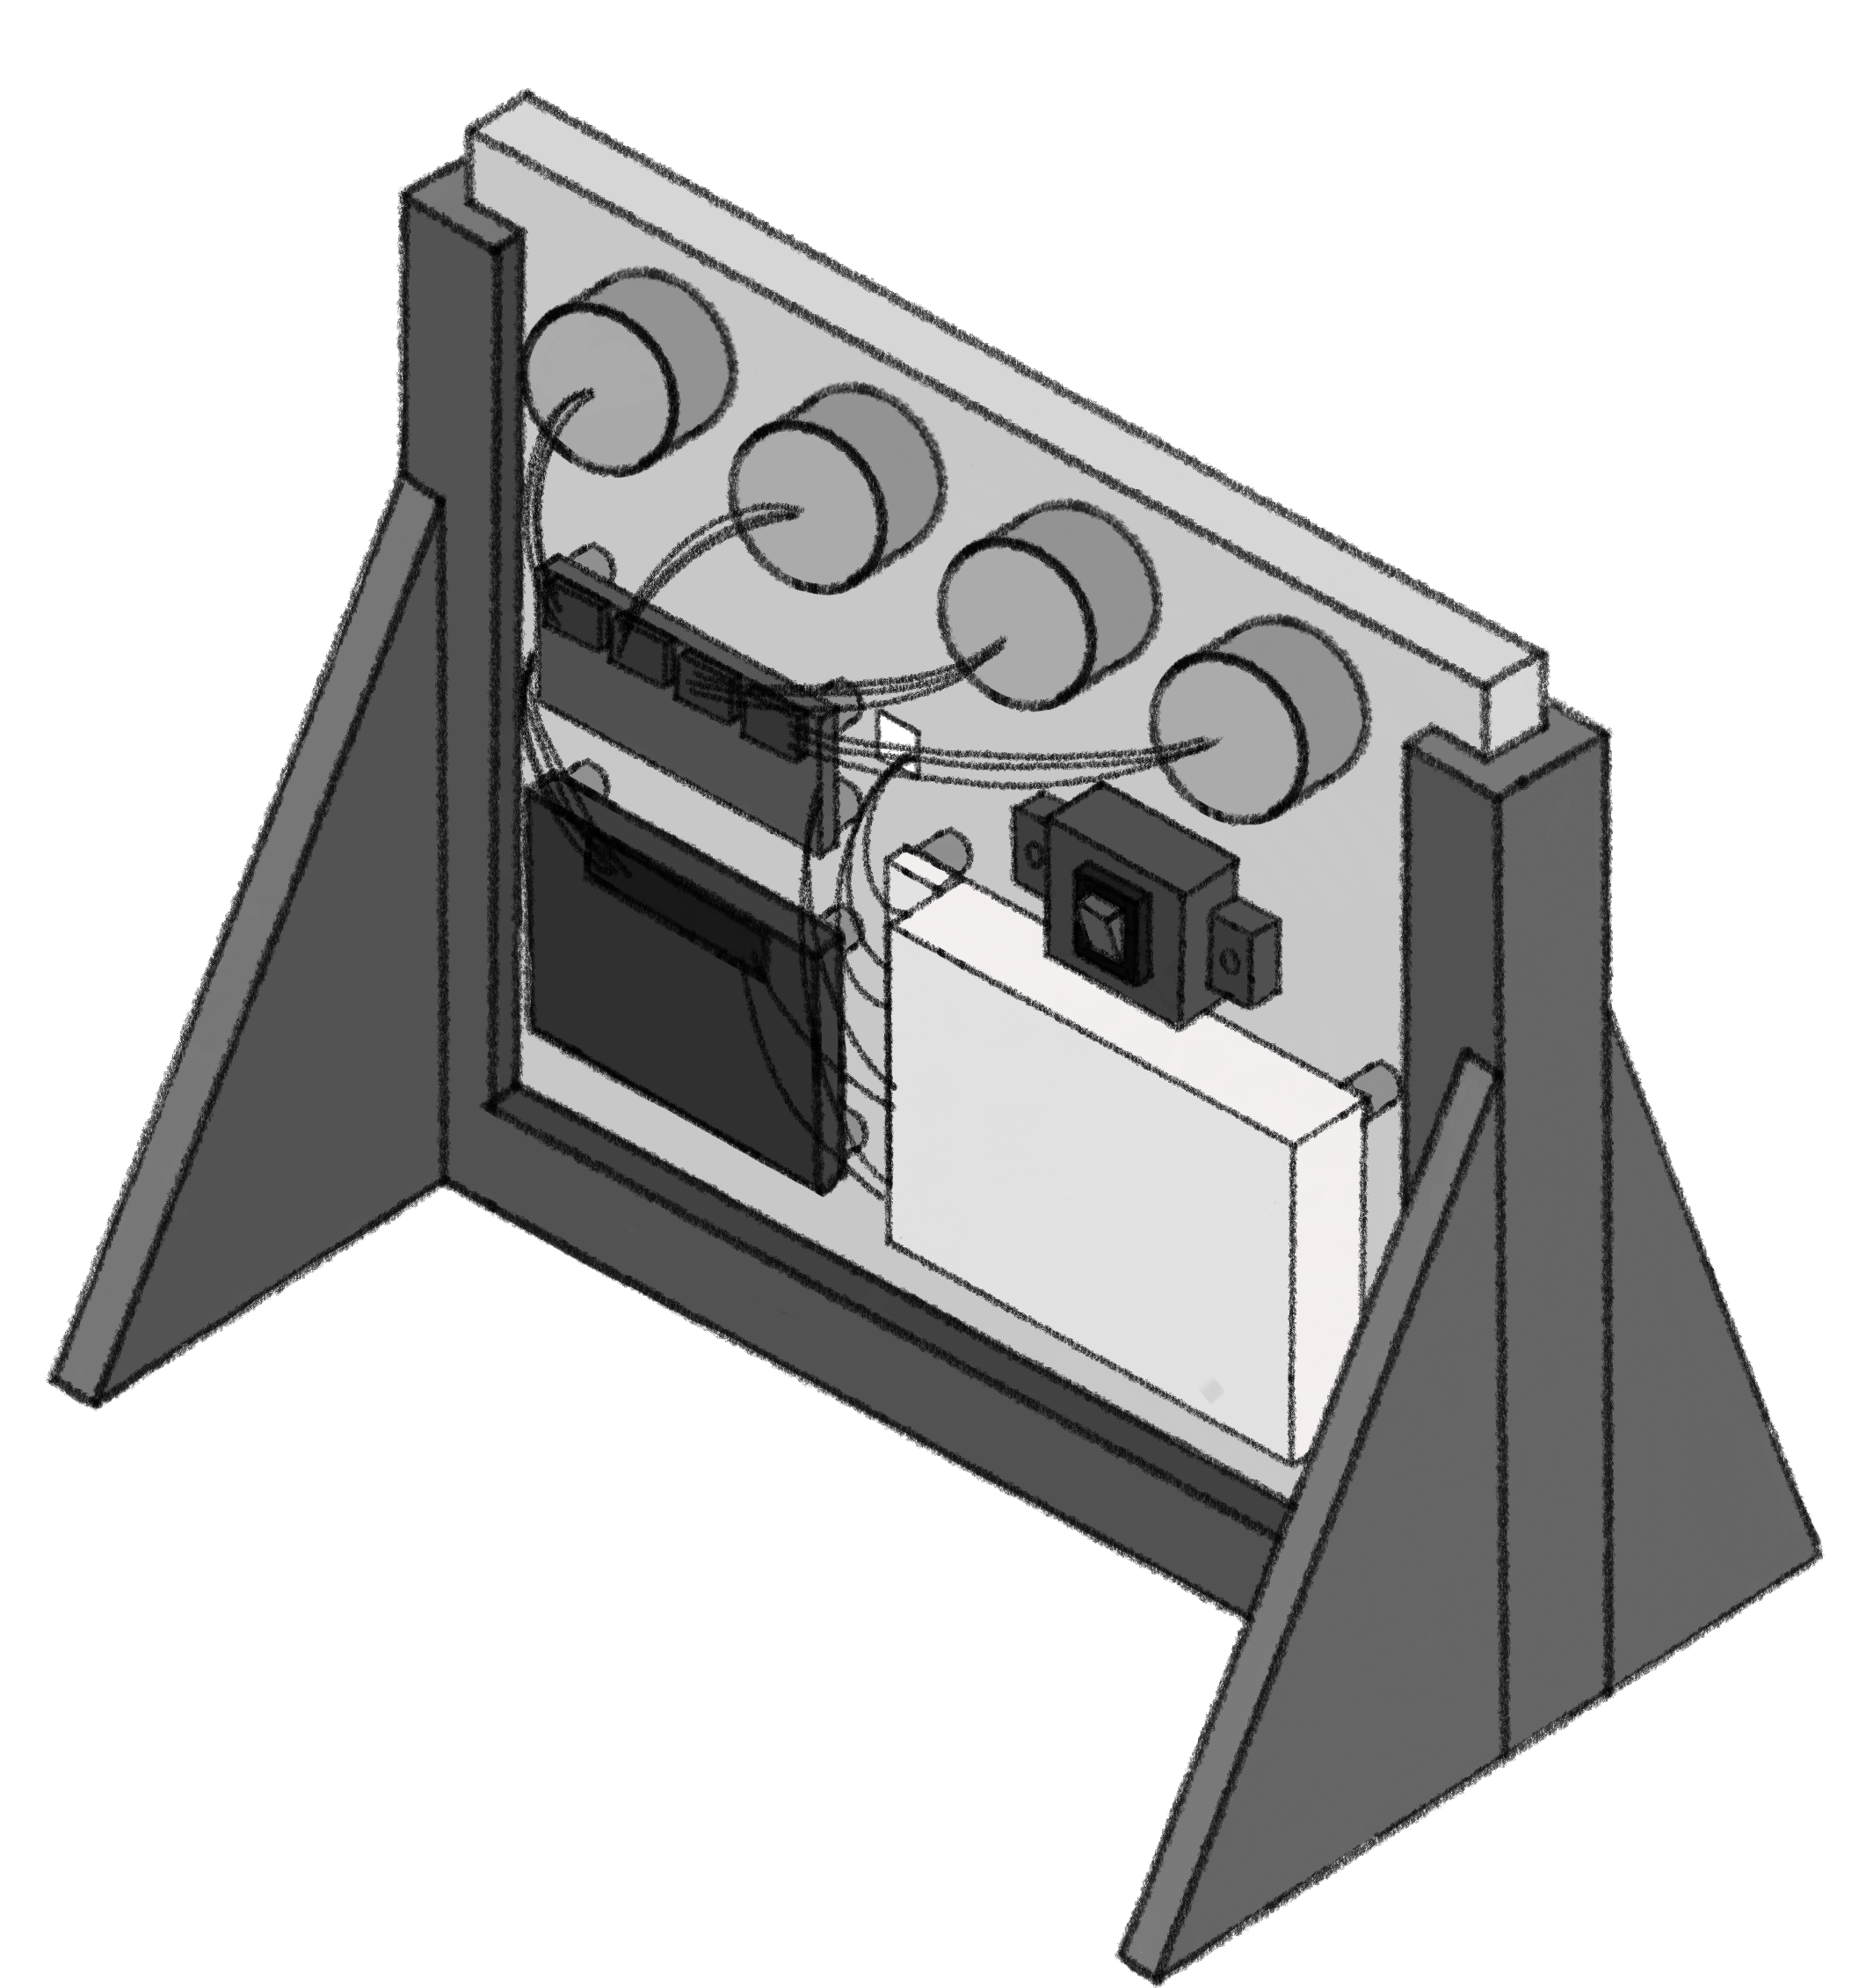
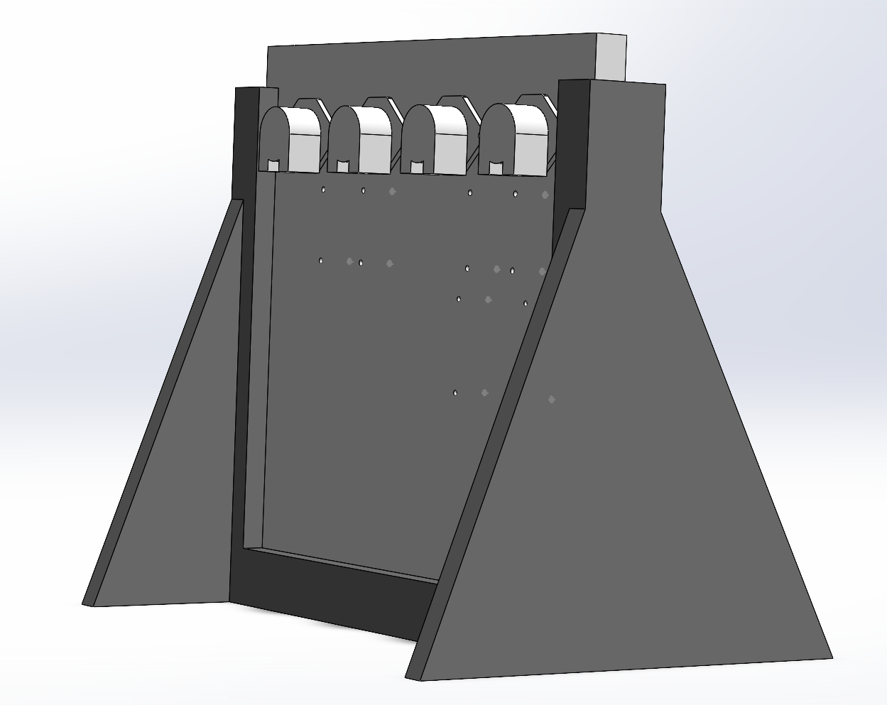
Aileen Cleary – 07/13/2023
Overall Goal: 1) Create an autonomous liquid refill system for Color Picker and 2) Write a program that dynamically visualizes (Color Picker’s) YAML files and experiment logs.
Weekly Goal: Successfully run Color Picker and focus on building Barty.
Progress:
Successfully ran Color Picker.
Revised sketch of Barty’s build.
Began 3D-modeling Barty components.
Worked on parts list for Barty.
Began integrating Barty into WEI, ran single step flow.
Challenges:
Trouble publishing to Globus running Color Picker.
Minor code errors while trying to run Barty server.
Got heavily rained on yesterday ☹.
Next Steps:
Finalize parts list and purchase.
Begin drilling holes for Barty board.
Finish 3D model, print holder for board and switch.
Start putting Barty together.
Continue integration of Barty into WEI.

